Slide 1

Capstone Project
Household Water Usage and Billing Monitor
Monitor household consumption, calculate bills, identify high usage, and make everyday water use easier to understand.
Household → Water Usage → Monitoring → Bill Calculation → Usage Analysis
Vanshika (2620080035)
Yashasvi (2620030227)
Notes:
Introduce the project as a small Java monitor that turns everyday household readings into a useful usage summary and bill.

Slide 2
ABSTRACT
Turning water use into insight
OBJECTIVES
What the program should deliver
The monitor turns separate household readings into a clear report that supports better daily decisions.
Monitor water usage
Calculate total consumption
Generate billing information
Detect high usage
Provide a usage breakdown
Monitor household water consumption
1
Calculate water bills based on usage
2
Display usage for different household areas
3
Identify high water consumption
4
Encourage water conservation
5
2
Notes:
Explain that the project has two layers: first, it observes and calculates; second, it presents the results in a form a household can understand.

Slide 3
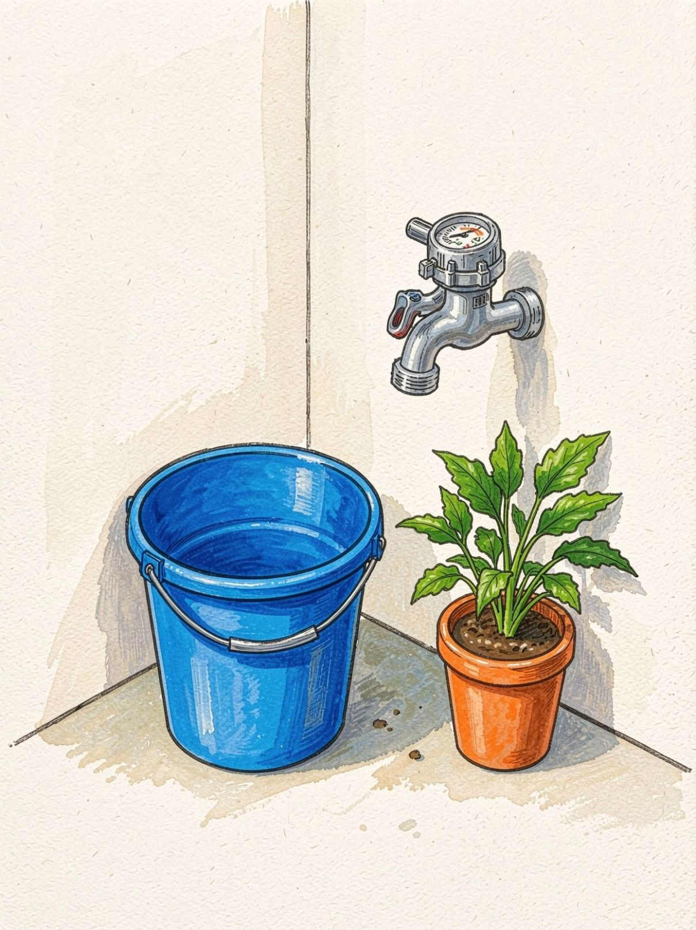
SYSTEM ARCHITECTURE
System architecture: input becomes a useful report
User
Input water usage
Java layer: Scanner/Input, Variables, Calculation, If-Else Conditions, Billing Logic, Usage Monitoring, and Output.
Calculate total usage
Bill calculation
Usage analysis
Output / report
FUTURE SCOPE:-
The Java layer combines input, variables, calculation, conditions, billing logic, usage monitoring, and output.
3
Notes:
Walk from the user to the report. The program is the transformation layer: it receives readings, calculates totals, applies billing logic, and explains the result.

Slide 4










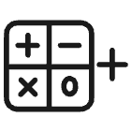
JAVA TOOLKIT
Main Java concepts used
Scanner
Input statement
Read user input.
Accept values.
Data types
Output statement
Define stored values.
Show results.
Variables
Hold readings.
Class and main method
Organize execution.
If-else statement
Choose a billing path.
Methods
Relational operators
Reuse calculations.
Compare usage.
Parameters and return values
Arithmetic operators
Send and receive data.
9
Calculate totals.
Notes:
This checklist gathers the concepts used across the monitor. Each item has a practical role in taking input, processing it, and returning a readable report.

Slide 5
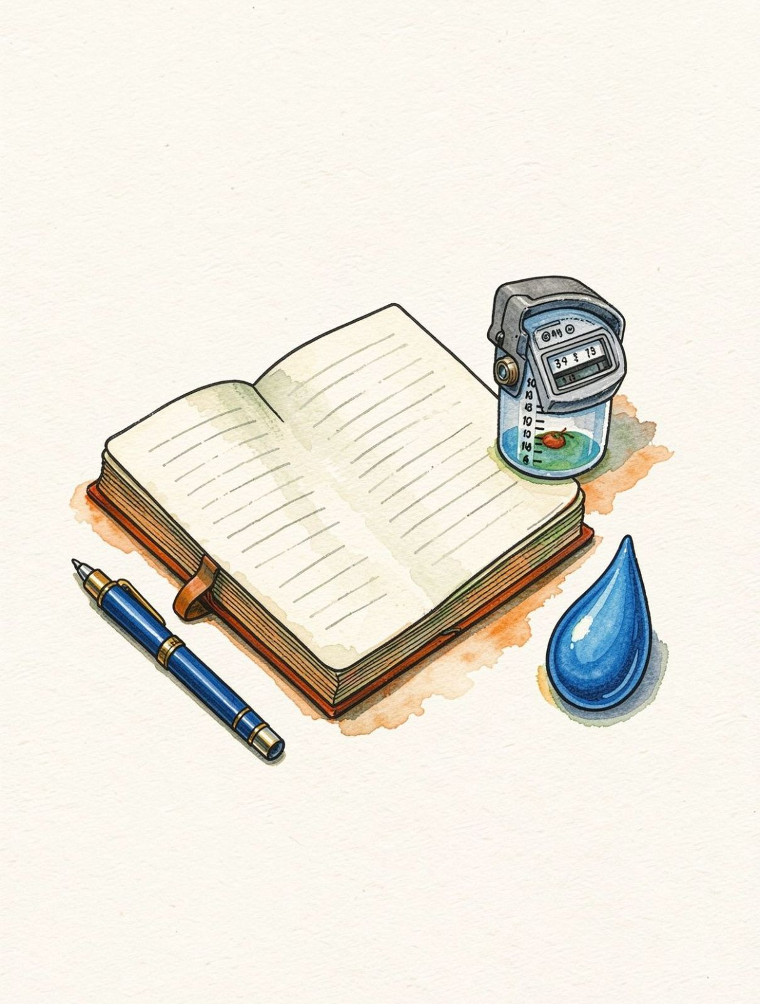
CO1 · JAVA FUNDAMENTALS
Java: the foundation
Class and main method
Variables and data types
Scanner for input
Input and output statements
Arithmetic operators
Relational operators
INPUT
Scanner sc = new Scanner(System.in);
int kitchenUsage;
Small building blocks make the monitor readable and testable.
4
Notes:
Connect each Java fundamental to the monitor: the class starts the program, variables store readings, Scanner receives input, and operators perform the calculations and comparisons.

Slide 6
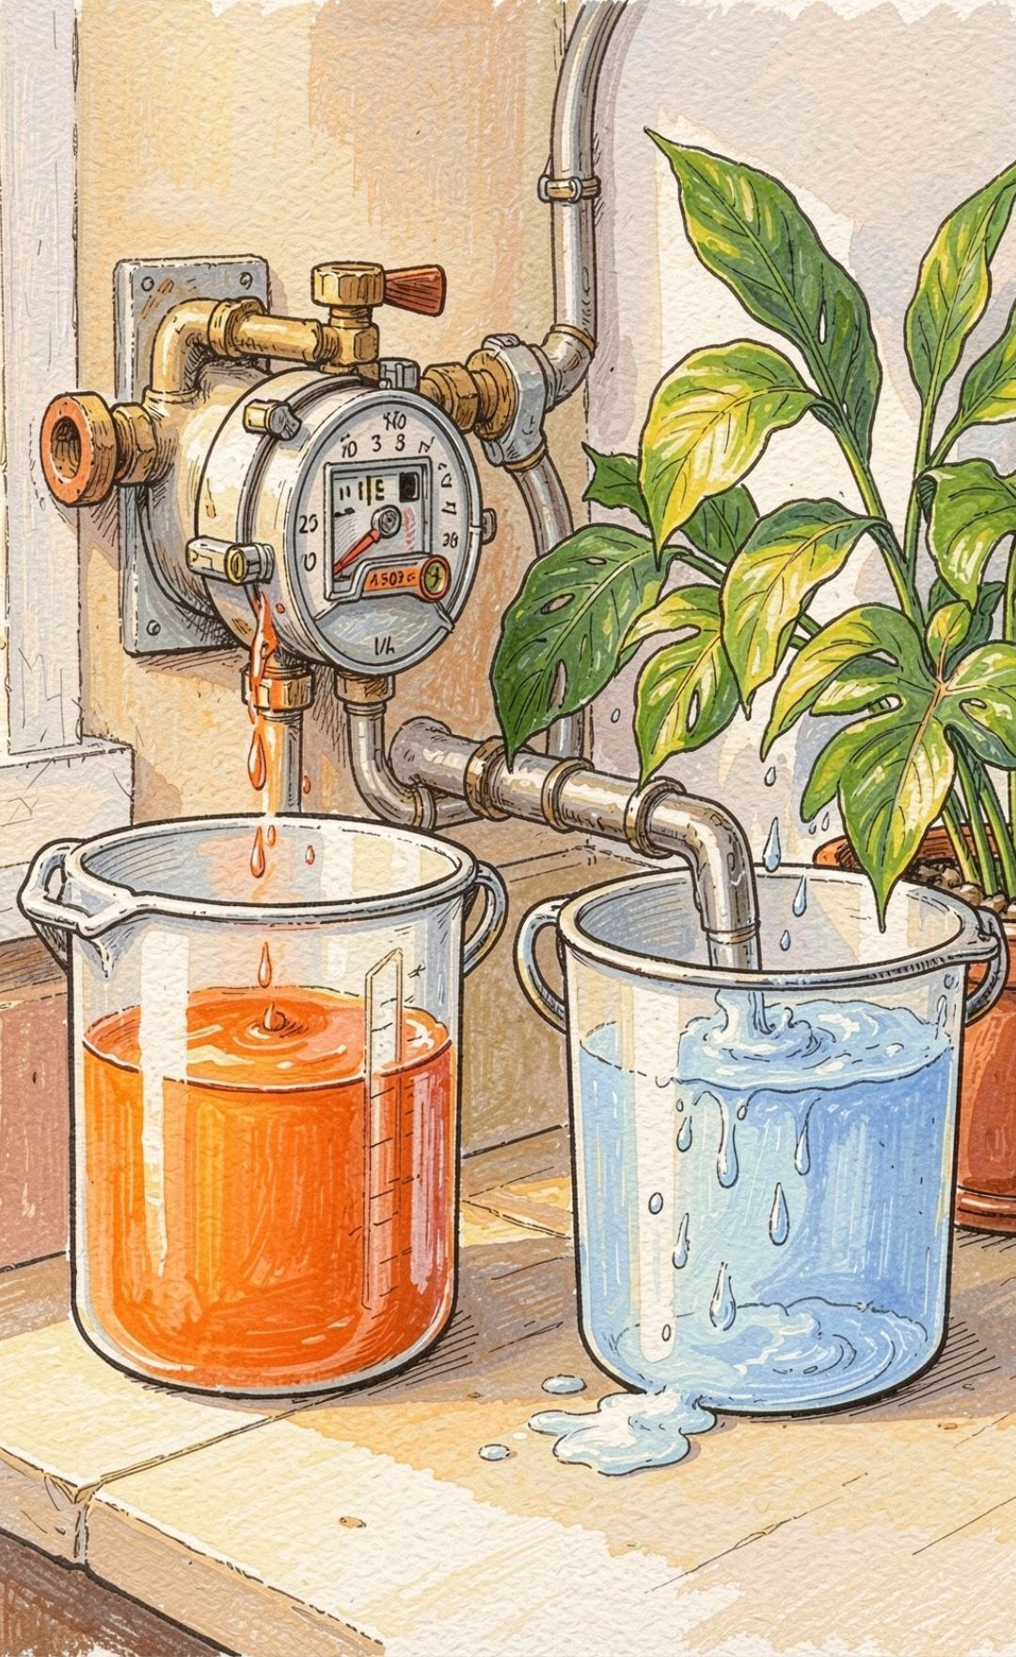
CO2 · DECISION LOGIC
CO2 — If-else turns consumption into a bill
Input → Check consumption → If/Else → Bill → Display
Read consumption and compare with 500 litres; If/Else selects the billing rule and displays a clear result.
Water consumption ≤ 500 litres
Water consumption > 500 litres
Bill = ₹100
Bill = ₹200
Comparison supports decision making. Billing logic converts a reading into a clear result.
5
Notes:
Emphasize that if-else is the decision point. The same input becomes a different bill depending on whether it is at or below 500 litres or above it.

Slide 7
CO3 · REUSABLE METHODS
Methods keep calculations reusable
A method receives values as parameters, performs one focused task, and returns a result the rest of the program can use.
Morning Usage
Evening Usage
Total Consumption
One input value.
Another input value.
One returned result.
calculateTotal(morningUsage, eveningUsage)
Reusable code keeps the program organized.
6
Notes:
Use the equation to explain the method aloud. The method adds morning and evening usage, then returns total water consumption for later billing and analysis.

Slide 8
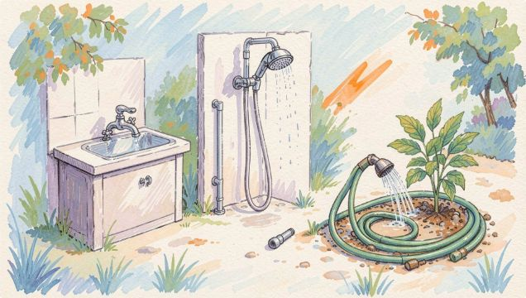
CO4 · MONITORING
Monitoring reveals patterns
Kitchen
Bathroom
Garden
Total usage
100 L
150 L
80 L
330 L
Usage meter
Usage meter
Usage meter
Combined view
Usage breakdown
High-usage detection
Leak or abnormal-usage alert
Compare household areas.
Find unusual readings.
Act before waste grows.
7
Notes:
Read the dashboard from individual areas to the total. A breakdown makes comparison possible; comparison makes high usage and possible abnormal usage easier to notice.

Slide 9
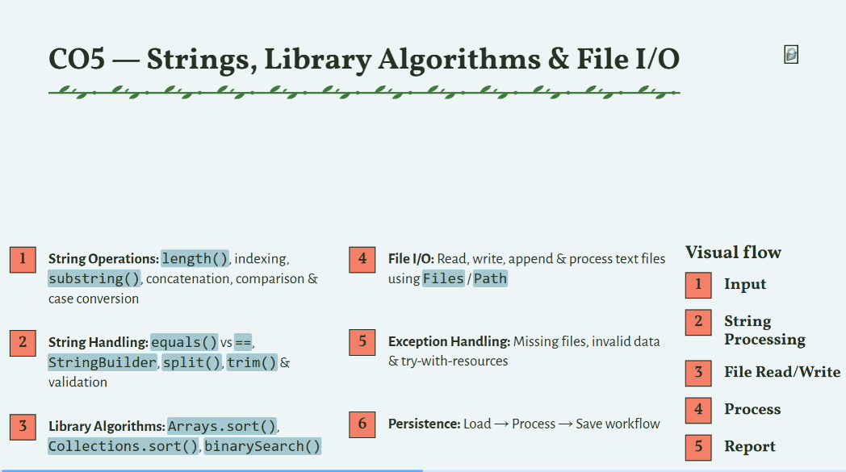

Slide 10
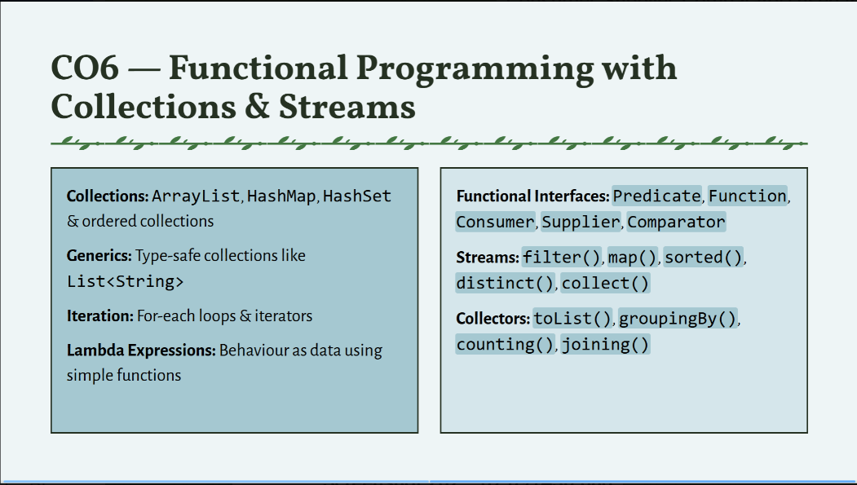

Slide 11
BILLING AND USAGE ANALYSIS
One view, one decision
Usage breakdown
Kitchen → 100 L
Bathroom → 150 L
Garden → 80 L
01
02
03
Total Consumption
Billing Logic
Final Bill
Total → 330 L
Daily usage monitoring
Consumption comparison
High-usage warning
Water-saving awareness
8
Notes:
Use the sample breakdown to show the decision path: 330 litres is the total, the billing rule interprets that total, and the monitor presents the final bill alongside useful awareness prompts.

Slide 12
Conclusion
The Household Water Usage and Billing Monitor demonstrates how Java and web development concepts can be applied to a real-world problem. It combines data handling, conditions, methods, Strings, file I/O, collections, and streams to monitor water usage, calculate bills, and generate useful reports. Overall, the system promotes efficient water usage and conservation.

